Slide 1
Version Control Protocols: GIT vs. SVN

Slide 2
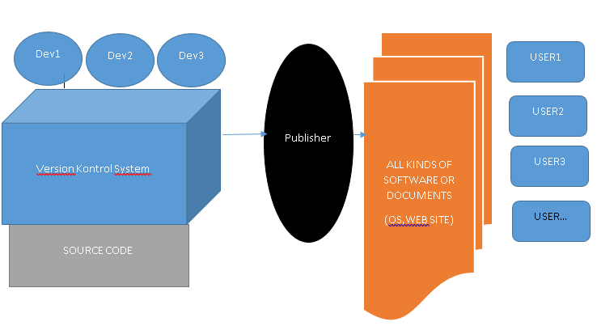
Version Control Protocols
What Is Version Control and Why Is it Important? Version control is important to keep track of changes — and keep every team member working on the right version.

Slide 3
Definitions
Repository, a data structure which stores metadata for a set of files or directory structure
Software repository, a storage location for software packages
Contrubutor
Get,Clone,Pull
Checkout,Undo Checkout
Check-in, Commit,Stage, Push

Slide 4
Version Control Protocols
In software engineering, version control
also known as
revision control
source control
source code management
computer programs,
documents,
large web sites,
or other collections of information
Version control is a component of software configuration management.
SCM can determine the "what, when, why and who" of the change

Slide 5
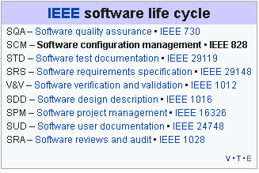
Position of Protocol
IEEE Software life cycle→SCM→Version Control
SCM

Slide 6
Version Control
In computer software engineering,
practice that tracks and provides control over changes to source code, document, configuretion files…
As teams design, develop and deploy software
Multiple copies of the different versions of the program,

Slide 7
Version Control Software Model
Local data model
In the local-only approach, all developers must use the same file system.(Revision Control System (RCS), Source Code Control System (SCCS) – part of UNIX)
Client-server model
In the client-server model, developers use a shared single repository.
IBM Rational ClearCase, Visual SourceSafe –by Microsoft; oriented toward small teams
Team Foundation Version Control - by Microsoft for Team Foundation Server, now Azure DevOps Server
Concurrent Versions System (CVS) – originally built on RCS, licensed under the GPL.
Subversion (SVN) – versioning control system inspired by CVS
TortoiseSVN Windows client for the Apache™ Subversion® version control system

Slide 8
Version Control Software Model
Distributed model
In the distributed approach, each developer works directly with their own local repository,
BitKeeper – was used in Linux kernel development (2002 – April 2005)
Git –, designed by Linus Torvalds based on the needs of the Linux kernel project; decentralized,
aims to be
fast,
flexible
robust

Slide 9
What is Distributed?
In software development,
Distributed version control (also known as distributed revision control)
Compared to centralized version control, this enables
Its full history, is mirrored on every developer's computer.
Automatic management branching and merging, speeds up most operations
Ability to work offline, and does not rely on a single location for backups.
Allows private work
Avoids relying on one physical machine as a single point of failure

Slide 10
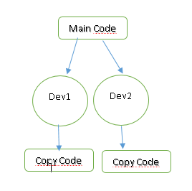
Distributed vs. centralized
DisAdvantages of DVCS
Initial checkout of a repository is slower as compared to checkout in a centralized version control system, because all branches and revision history are copied to the local machine by default.
Additional storage required for every user to have a complete copy of the complete codebase history.

Slide 11
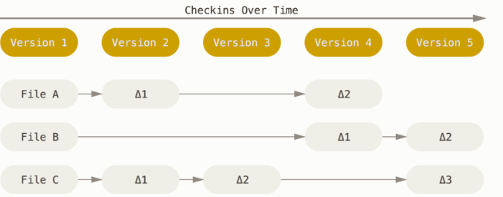
What is Git?
Git is a free and open source
The major difference between Git andAny other VCS use delta-based method

Slide 12
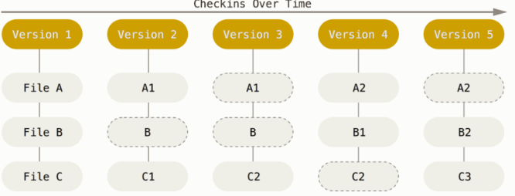
Git thinks about its data more like a stream of snapshots.
This makes Git more like a mini filesystem with some incredibly powerful tools built on top of it, rather than simply a VCS.

Slide 13
What is Git?
Nearly Every Operation Is Local
For example, to browse the history of the project, Git doesn’t need to go out to the server to get the history and display it for you
Git Has Integrity (SHA-1 hash)
Everything in Git is checksummed before it is stored and is then referred to by that checksum. This means it’s impossible to change the contents of any file or directory without Git knowing about it.
Git Generally Only Adds Data
You can lose or mess up changes you haven’t committed yet, but after you commit a snapshot into Git, it is very difficult to lose, especially if you regularly push your database to another repository.

Slide 14
Operations of Contrubutor
GET LATEST VERSIYON | FORK, CLONE OR COPY
GET | PULL
MERGE | MERGE
CHECK-IN | STAGE-COMMIT-PUSH
 | PULL REQUEST –MERGE REQUEST (FORK)

Slide 15
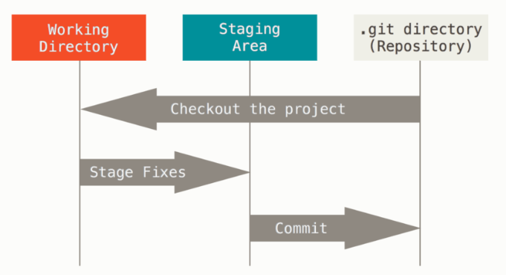
Git -The Three States
modified, staged, and committed:
Modified means that you have changed the file but have not committed it to your database yet.
Staged means that you have marked a modified file in its current version to go into your next commit snapshot.
Committed means that the data is safely stored in your local database.

Slide 16
Git Protocols to transfer data
Git uses Local, HTTP, Secure Shell (SSH) and Git
LOCAL→remote repository is in another directory on the same host
The most basic is the Local protocol, in which the remote repository is in another directory on the same host.
$ git clone /srv/git/project.git
File-based repositories are that they’re simple and they use existing file permissions and network access. If you already have a shared filesystem to which your whole team has access, setting up a repository is very easy.
HTTP→ Dumb HTTP Smart HTTP ,

Slide 17
Git Protocols to transfer data
1.Dumb HTTP
If the server does not respond with a Git HTTP smart service, the Git client will try to fall back to the simpler Dumb HTTP protocol. The Dumb protocol expects the bare Git repository to be served like normal files from the web server
2.Smart HTTP
Smart HTTP operates very similarly to the SSH or Git protocols but runs over standard HTTPS ports and can use various HTTP authentication mechanisms
SSH
A common transport protocol for Git when self-hosting is over SSH. $ git clone ssh://[user@]server/project.git

Slide 18
Git Protocols to transfer data (TCP)
-Finally, we have the Git protocol it listens on a dedicated port (9418) service similar to the SSH protocol, but with absolutely no authentication.
-The Git protocol is
fastest network transfer protocol available.
same data-transfer mechanism as the SSH protocol but without the encryption and authentication overhead.
-The downside of the Git
protocol is the lack of authentication
with SSH or HTTPS access for the few developers who have push (write) access
difficult protocol to set up. It also requires firewall access to port 9418,

Slide 19
What is SVN
SVN stands for Subversion. It is called as SVN because of its commands (its command name svn). It is a centralized version control system. It is an open-source tool for version control.
SVN acts as the time machine for the developers and allows them to go back and browse the history of the project.
There are a large number of projects that are still running on the Subversion.
Subversion is open-source and comes under the Apache License,

Slide 20
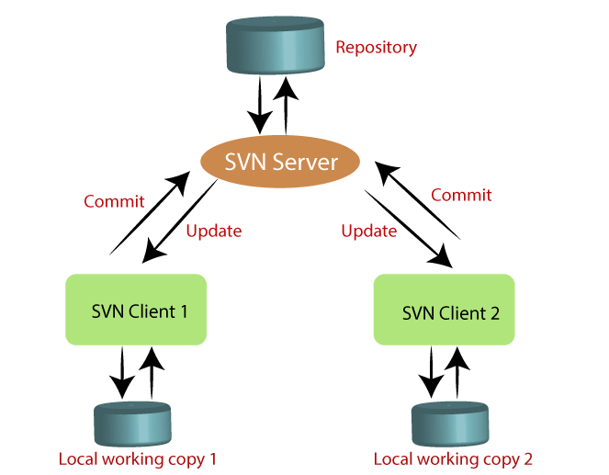
SVN
The features of SVN are as follows:
It supports atomic commits (Either it will occur or not).
It keeps a full revision history on server.
It provides file locking for the files that cannot be merged.
The usage of SVN client is as follows:
It communicates with the SVN server.
It provides remote and manual access.
It provides the interface.

Slide 21
Svn Protocols to transfer data (TCP)
http://repos
http:// has a serious overhead, especially when dealing with thousands of small files.
https://repos
preferably https because of the encryption-and-authentication layer
svn://repos
svn:// or svn+ssh:// are faster than HTTP(S)
svn+ssh://repos
svn+ssh is the svn protocol run inside a SSH tunnel. The client uses SSH to log on the remote server and remotely runs the svn command in that tunnel.

Slide 22
SVN | Git
It's a Centralized version control system | It's a distributed version control system.
It is revision control. | Git is an SCM (source code management).
It does not keep a cloned repository. | It has a cloned repository.
Branches in SVN are a folder that takes place in the repository. Some special commands are required For merging the branches. | The Git branches are familiar to work. The Git system helps in merging the files quickly and also assists in finding the unmerged ones.
It has an internationalized revision number. | It does not have a Global revision number.
SVN does not contain any cryptographically hashed contents. | It has cryptographically hashed contents that protect the contents from repository corruption taking place due to network issues or disk failures.
SVN stores content as files. | Git stored content as metadata.
SVN's content is less secure than Git. | Git has more content protection than SVN
SVN's content is less secure than Git. | Git has more content protection than SVN.
CollabNet, Inc developed SVN. | Linus Torvalds developed git for Linux kernel.
SVN is distributed under the open-source license. | Git is distributed under GNU (General public license)

Slide 23
Teşekkürler

